Slide 1

Data Programming in Python _________________ Booleans and Flow Control

Slide 2
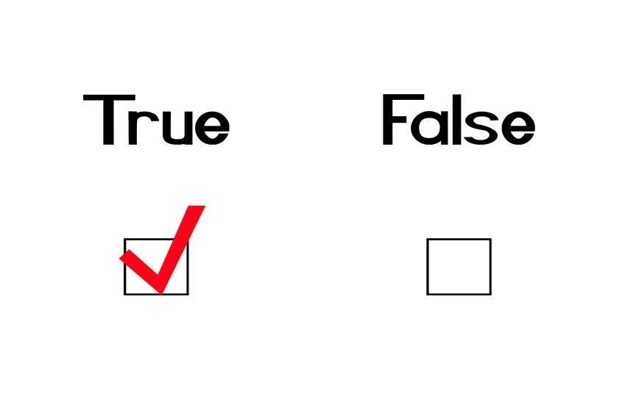
Boolean Data Type
Boolean expressions ask a question and produce a True or False result which we use to control program flow

Slide 3
Boolean Data Type
Boolean expressions using comparison operators evaluate to True / False
Python | Meaning
< | Less than
<= | Less than or Equal to
== | Equal to
>= | Greater than or Equal to
> | Greater than
!= | Not equal
Remember: “=” is used for assignment.

Slide 4
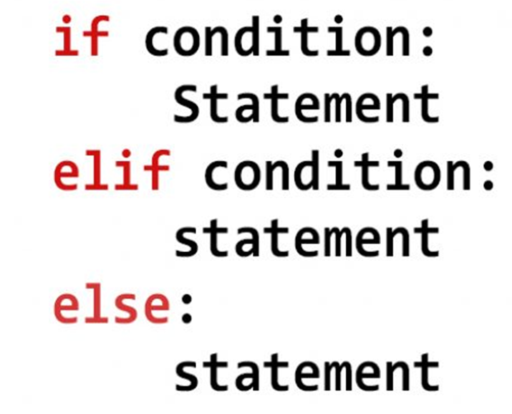
Conditional Statements
First item in if/elif/else that is True
Go inside and execute statement

Slide 5
Conditional Statements
First item in if/elif/else that is True
Go inside and execute statement

Slide 6
Conditional Statements
x = 0
if x < 2 :
print('small')
elif x < 10 :
print('Medium')
else :
print('LARGE')
print('All done')

Slide 7
Conditional Statements
x = 0
yes
x < 2
print('small')
no
yes
x < 10
print('Medium')
no
print('LARGE')
print('All done')

Slide 8
Conditional Statements
x = 5
if x < 2 :
print('small')
elif x < 10 :
print('Medium')
else :
print('LARGE')
print('All done')

Slide 9
Conditional Statements
x = 5
yes
x < 2
print('small')
no
yes
x < 10
print('Medium')
no
print('LARGE')
print('All done')

Slide 10
Conditional Statements
x = 20
if x < 2 :
print('small')
elif x < 10 :
print('Medium')
else :
print('LARGE')
print('All done')

Slide 11
Conditional Statements
x = 20
yes
x < 2
print('small')
no
yes
x < 10
print('Medium')
no
print('LARGE')
print('All done')

Slide 12
Compound Conditions
and
or
not
Logical Expression | Result
expression1 and expression2 | True if both expressions are True
expression1 or expression2 | True if at least one expression is True
not expression1 | True if expression1 is False

